Slide 1
Unit-1
Mining Frequent Patterns, Associations, and Correlations: Basic Concepts - Frequent Itemset Mining Methods - Pattern evaluation methods

Slide 2
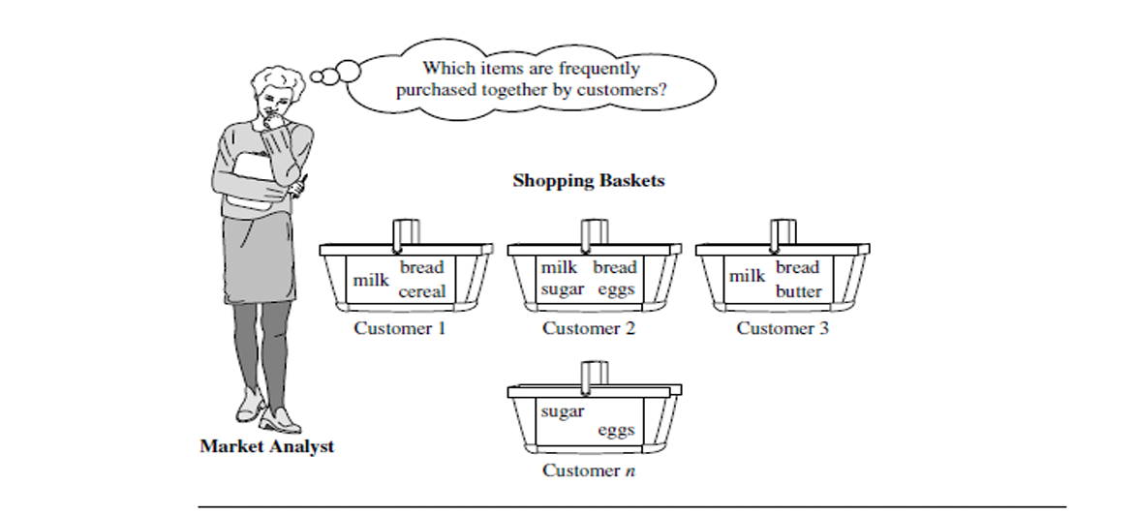
Mining Frequent Patterns, Associations, and Correlations: Basic Concepts
Frequent patterns are patterns (e.g., itemsets, subsequences, or substructures) that appear frequently in a data set.
For example, a set of items, such as milk and bread, that appear frequently together in a transaction data set is a frequent itemset.
Market Basket Analysis: A Motivating Example

Slide 3
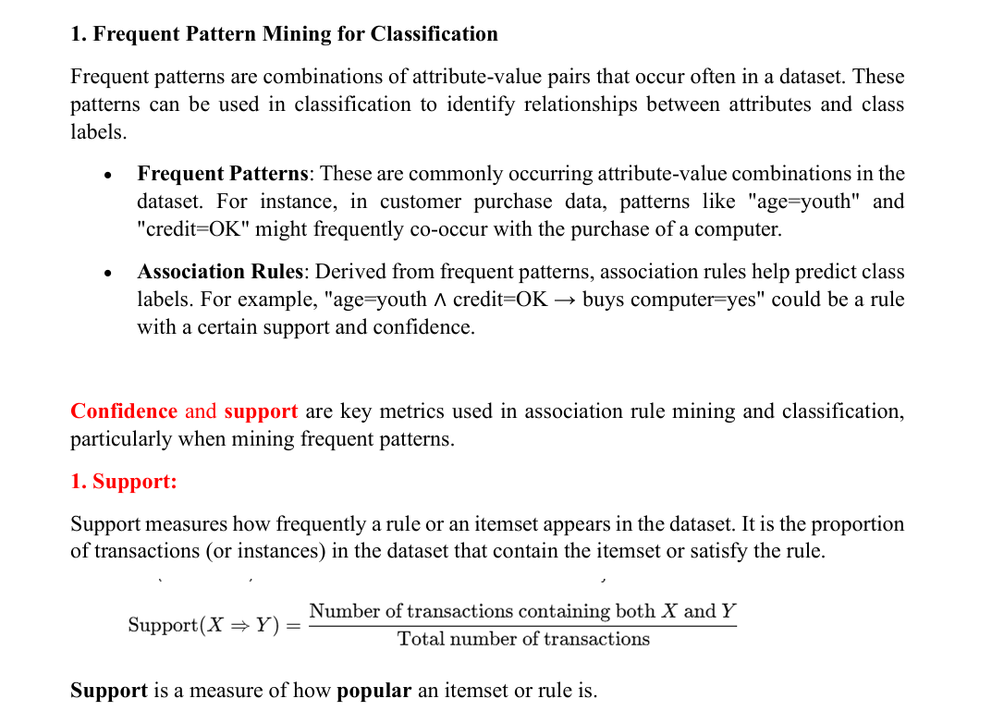

Slide 4
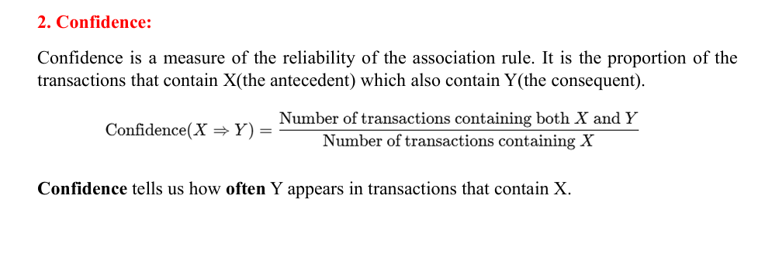

Slide 5
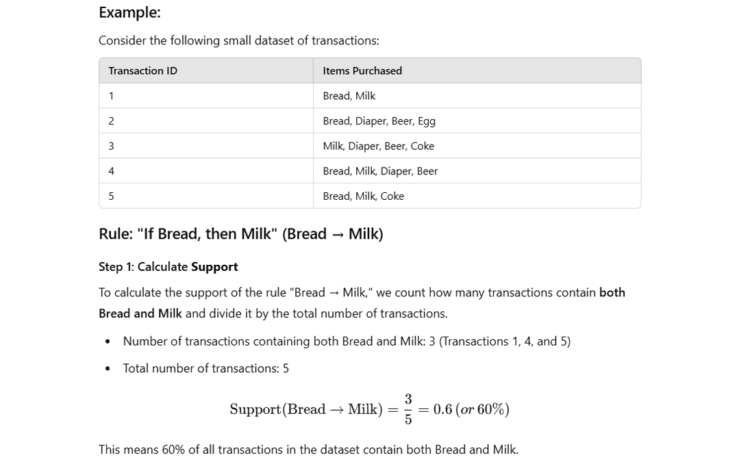

Slide 6
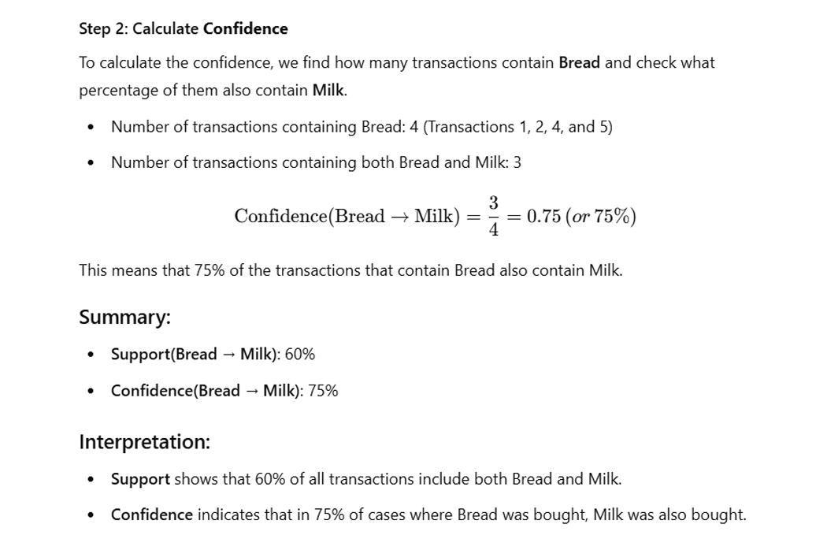

Slide 7
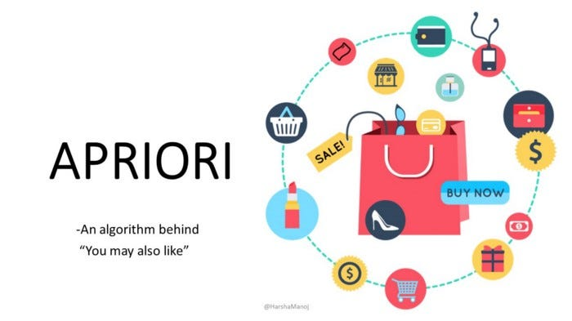

Slide 8
Apriori Algorithm: A Candidate Generation-and-Test Approach
The Apriori Algorithm is a fundamental method used in data mining to identify frequent itemsets and generate association rules. It is particularly useful in applications like market basket analysis, where the goal is to find relationships between items purchased together.
Key Features of the Apriori Algorithm:
Frequent Itemset Mining: It identifies sets of items that frequently occur together in a dataset.
Association Rule Learning: It derives rules like "If a customer buys X, they are likely to buy Y."
Iterative Approach: The algorithm works in multiple passes:
Starts with single items and identifies frequent ones.
Combines these to form larger itemsets, continuing until no more frequent itemsets can be found.
Steps of the Algorithm:
Generate Candidate Itemsets: Create combinations of items.
Prune Infrequent Itemsets: Remove itemsets that do not meet the minimum support threshold.
Repeat: Expand the size of itemsets and repeat the process until no further frequent itemsets are found.
Generate Rules: Use frequent itemsets to create association rules that meet a minimum confidence threshold.

Slide 9
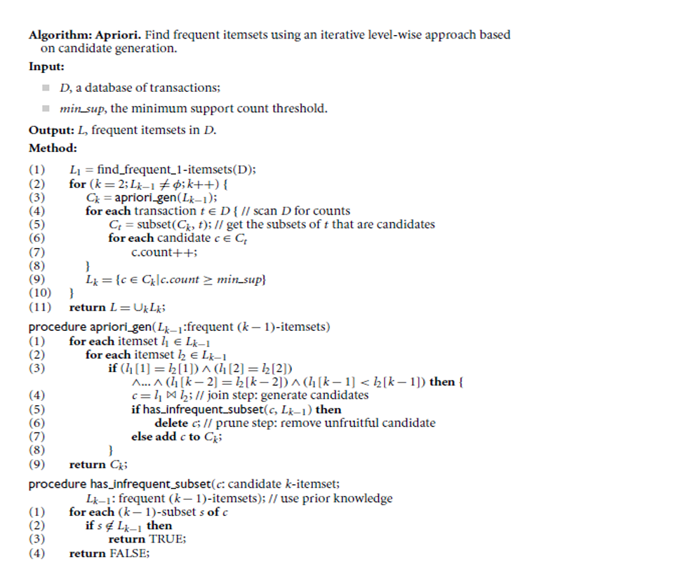

Slide 10
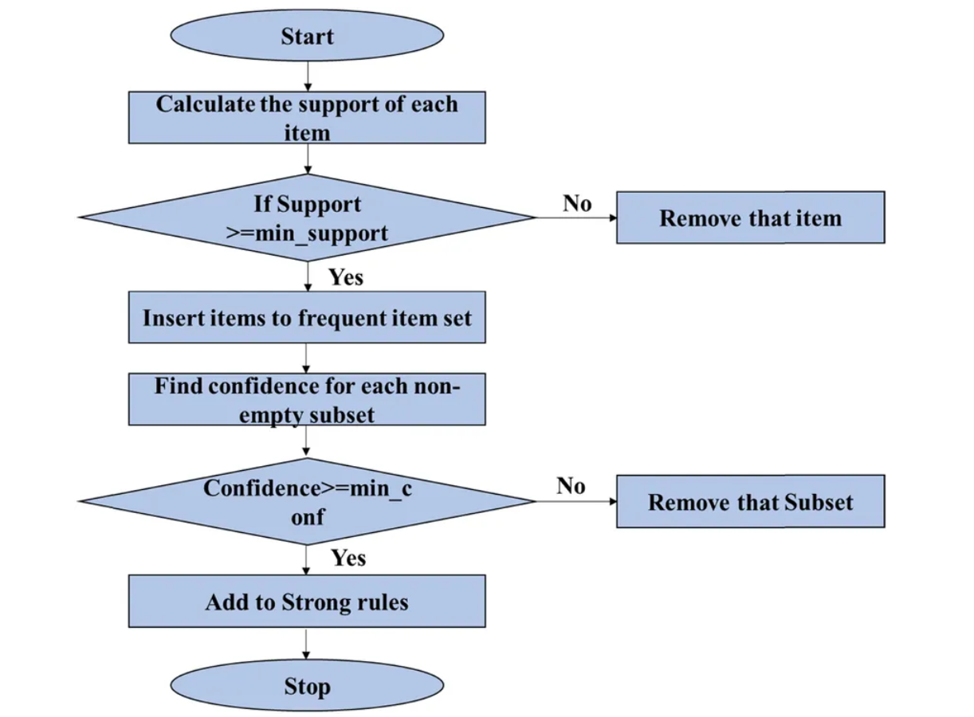
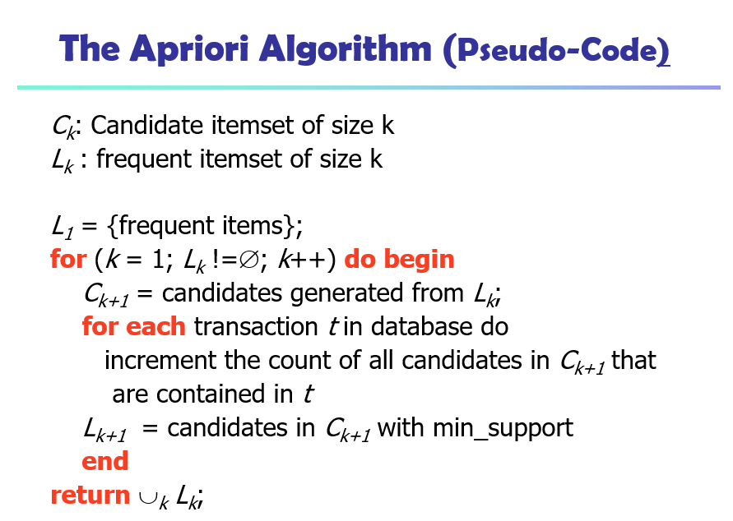

Slide 11
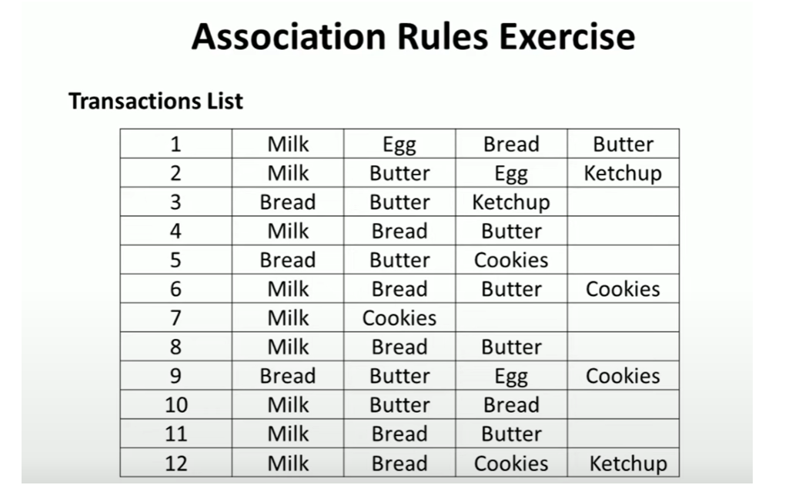
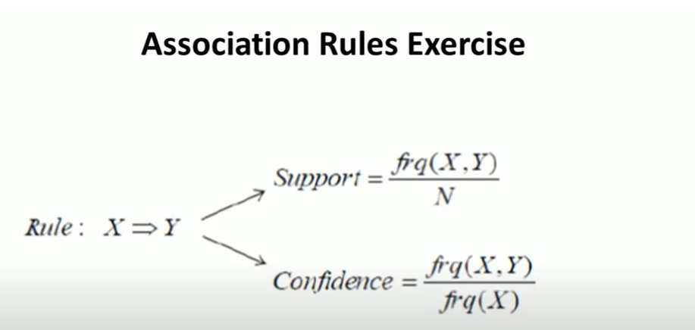

Slide 12
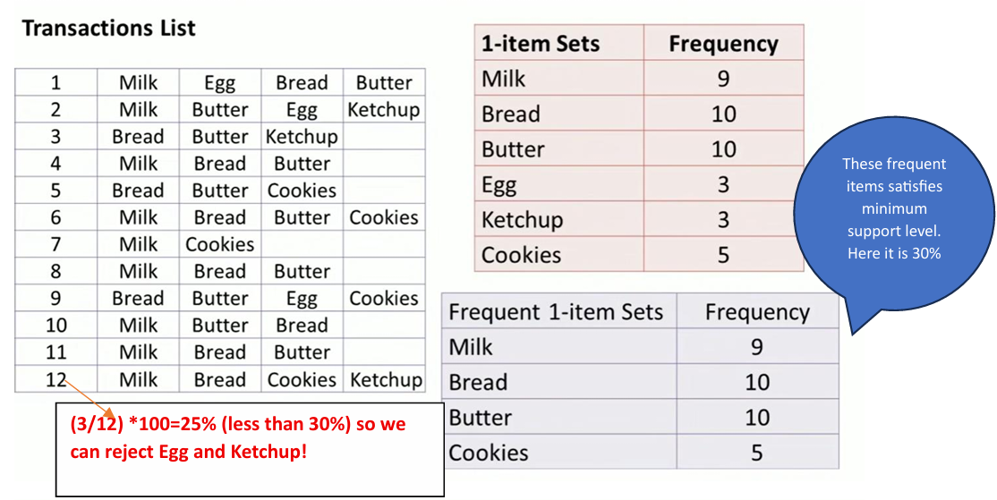

Slide 13
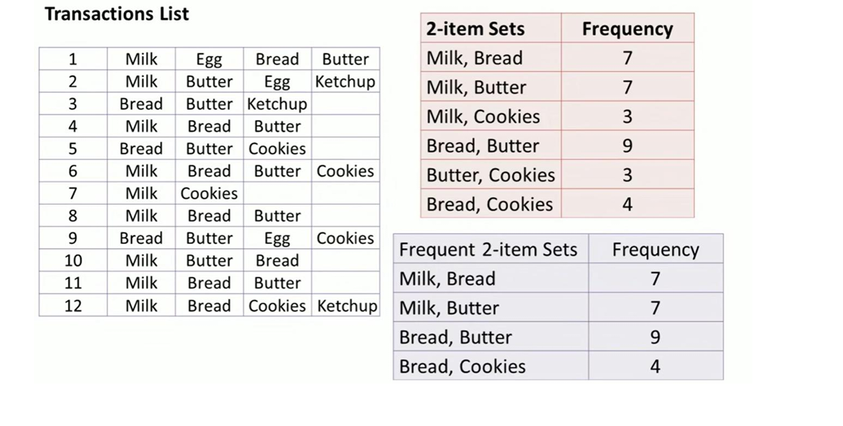

Slide 14
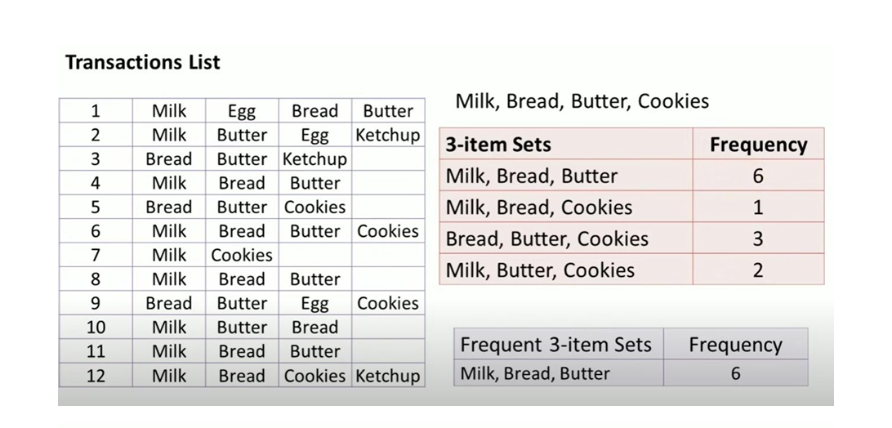

Slide 15
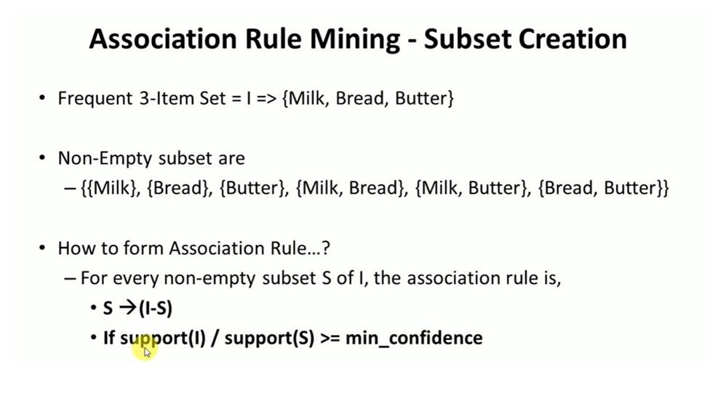

Slide 16
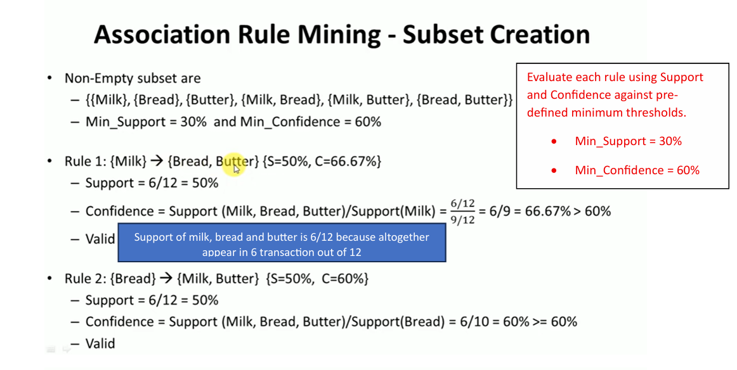

Slide 17
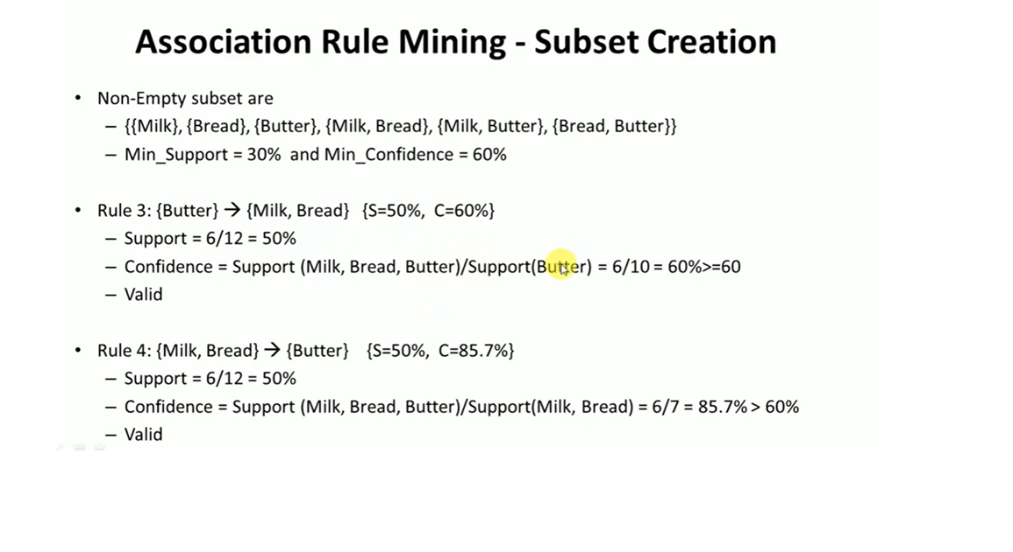

Slide 18
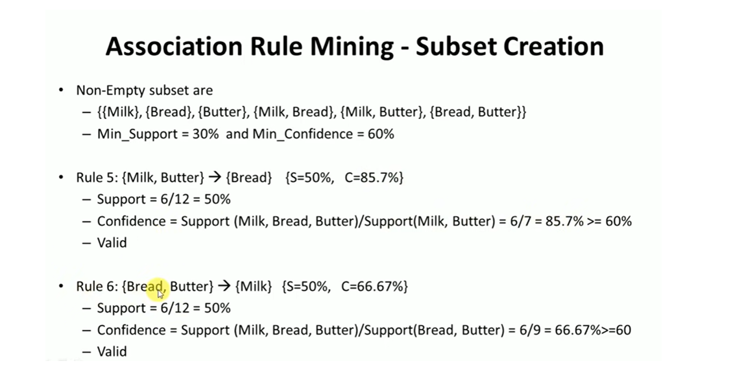

Slide 19
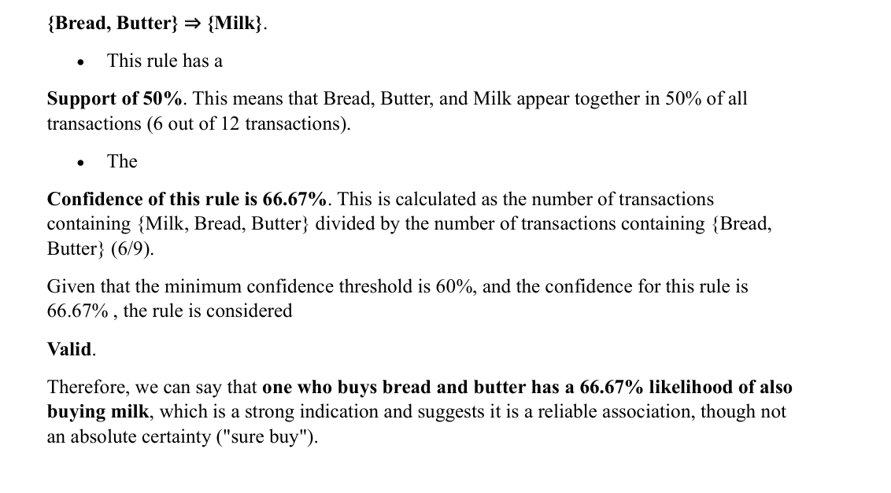

Slide 20
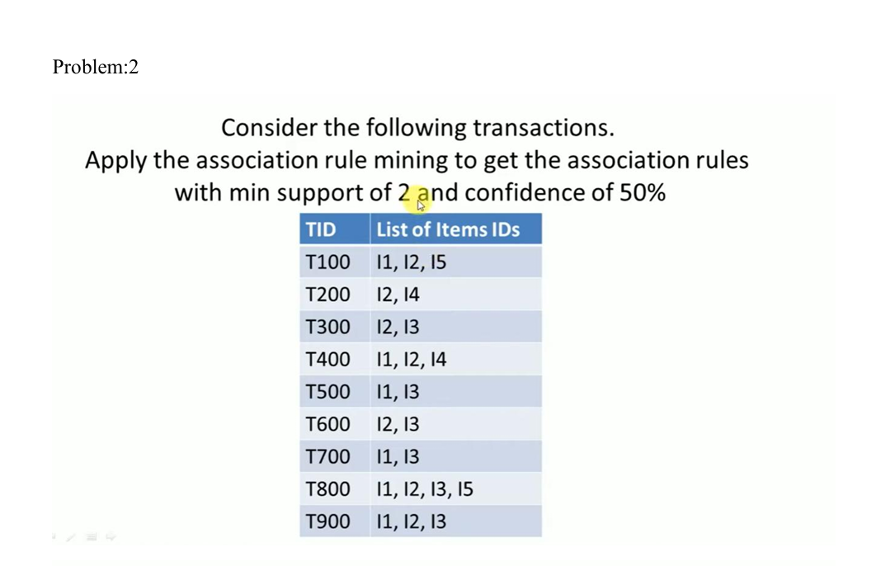
Assignment Problem

Slide 21
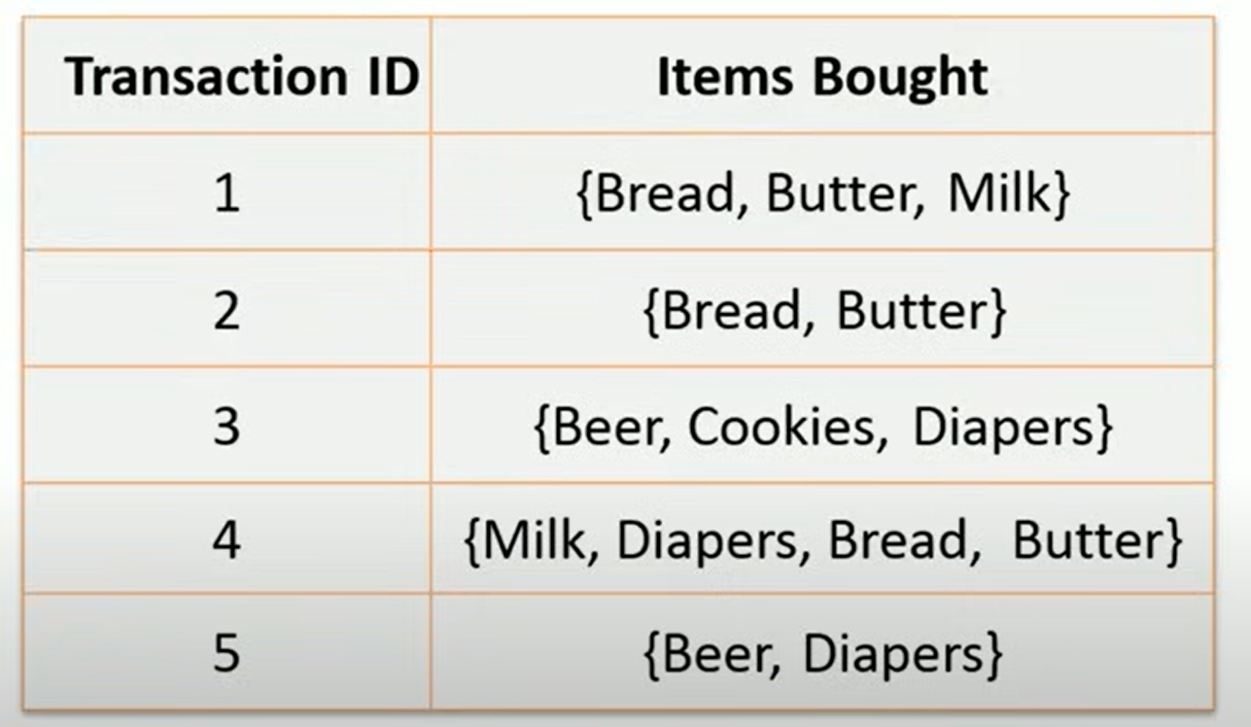
Classwork Problem
Assume that Mini_support= 40%
Mini_Confidence=70%

Slide 22
Improving Efficiency of Apriori
Hash-Based Technique to Reduce Candidate 2-itemsets (C2) in Apriori Algorithm

Slide 23
Hash-Based Technique
When generating C2, we optimize using a hash table while scanning transactions for L1.
Example Hash Function (just like before):
Let's assume order of items:
Milk = 1
Bread = 2
Butter = 3
Cookies = 4
Use hash function: h({X,Y}) = (order of X + order of Y) % 5

Slide 24
Now hash all possible L1 2-itemsets from each transaction:
Example:
T1 = {Milk, Bread, Butter} ⇒ pairs:
Milk, Bread → 1+2 = 3 % 5 = 3 (bucket number)
Milk, Butter → 1+3 = 4 % 5 = 4
Bread, Butter → 2+3 = 5 % 5 = 0
Continue for all 12 transactions...

Slide 25
Hash technique
Now apply support threshold (min = 4):
✅ Only keep itemsets in buckets where count ≥ 4:
Bucket 0 (Bread, Butter)
Bucket 3 (Milk, Bread)
⛔ Prune itemsets in buckets with < 4:
e.g., Milk, Cookies; Butter, Cookies...
Final Pruned C2 (After Hashing):
{Milk, Bread}
{Bread, Butter}
💡 This is a smaller candidate set than what was produced by ordinary Apriori. Then we do the actual counting of only these to confirm support.
Then count how many times each bucket is hit:
Bucket | Count | Sample Itemsets in Bucket
0 | 6 | Bread, Butter
3 | 4 | Milk, Bread
4 | 3 | Milk, Butter, etc.
Others | ≤ 3 | (Not meeting threshold)

Slide 26
Summary: Ordinary vs Hash-Based Apriori
Step | Ordinary Apriori | Hash-Based Apriori
L1 | Found by counting all single items | Same
C2 | All possible 2-itemsets from L1 | Hashed first, low-support buckets pruned
Scanning effort | Higher (all C2 scanned) | Lower (fewer C2s to evaluate)
Output L2 | {Milk, Bread}, {Milk, Butter}, {Bread, Butter}, {Bread, Cookies} | Mostly {Milk, Bread}, {Bread, Butter}

Slide 27
Transaction Reduction
If a transaction doesn’t contain any frequent k-itemsets, it can't produce any frequent (k+1)-itemsets.
Suppose we have transaction as below
T1: {A, B, C}
T2: {A, C}
T3: {D, E}
T4: {A, D}
Now check which transactions contain at least one of these frequent 2-itemsets:
✅ T1: has {A, B} and {A, C} → keep
✅ T2: has {A, C} → keep
❌ T3: has {D, E} → remove
❌ T4: has {A, D} → remove (if {A, D} is not frequent)
💡 Benefit:
In the next iteration (for 3-itemsets), you can skip T3 and T4
reducing the dataset size and speeding up computation.
Let’s say after scanning for frequent 2-itemsets, only these are frequent:
{A, C}
{A, B}

Slide 28
Partitioning-Mine locally frequent itemsets from data partitions, and then scan again to verify global support.
Example:
Imagine your dataset has 100,000 transactions. You divide them into
4 partitions (P1, P2, P3, P4) of 25,000 transactions each.
Phase I: Local Frequent Mining
From each partition, you find locally frequent itemsets:
P1: {A, B}, {C}
P2: {A, B}, {B, C}
P3: {B}, {C}
P4: {A}, {C}
Now take the union of all locally frequent itemsets: {A}, {B}, {C}, {A, B}, {B, C}.
Phase II: Global Support Check
Scan full database only for these candidates, count support, and identify which are globally frequent.
💡 Benefit:
Only 2 scans of the DB (vs. multiple in standard Apriori).
Each partition fits in main memory, so it's efficient.

Slide 29
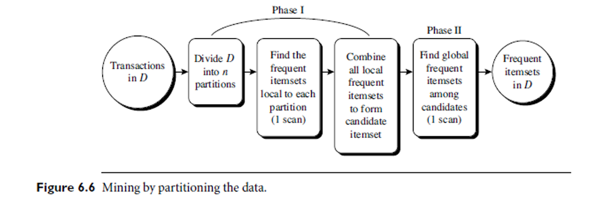

Slide 30
Sampling-Mine a random subset (sample) of the data to approximate the frequent itemsets.
Example:
Original data has 1 million transactions.
You take a random sample of 100,000 transactions (10%) and
find these frequent itemsets:
{A, C}, {B}, {C}
These are candidate frequent itemsets.
Then you:
Either estimate support in full data using confidence intervals, or
Verify actual support in a second full scan.
💡 Tradeoff:
✔️ Faster since it works on a subset.
❌ Might miss rare but globally frequent itemsets.

Slide 31
Dynamic Itemset Counting (DIC)-Add new candidate itemsets dynamically during a scan instead of waiting for the next full pass.
Example:
Let’s say the DB is scanned in blocks of 10,000 transactions.
In Block 1, {A} and {B} seem frequent
so {A, B} is added as a new candidate immediately, before waiting for the full pass.
In standard Apriori, you'd wait until the full 1st pass is done before considering {A, B}.
💡 Benefit:
Fewer total scans.
Allows for adaptive candidate generation mid-scan.
Good when data is streamed or block-partitioned.

Slide 32
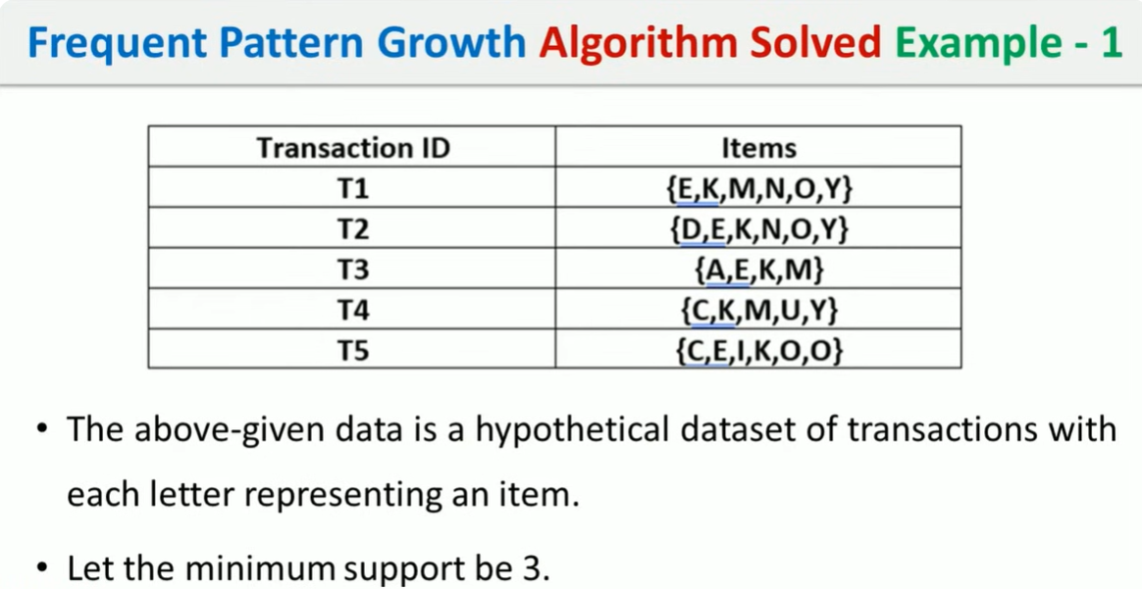
FP Algorithm

Slide 33
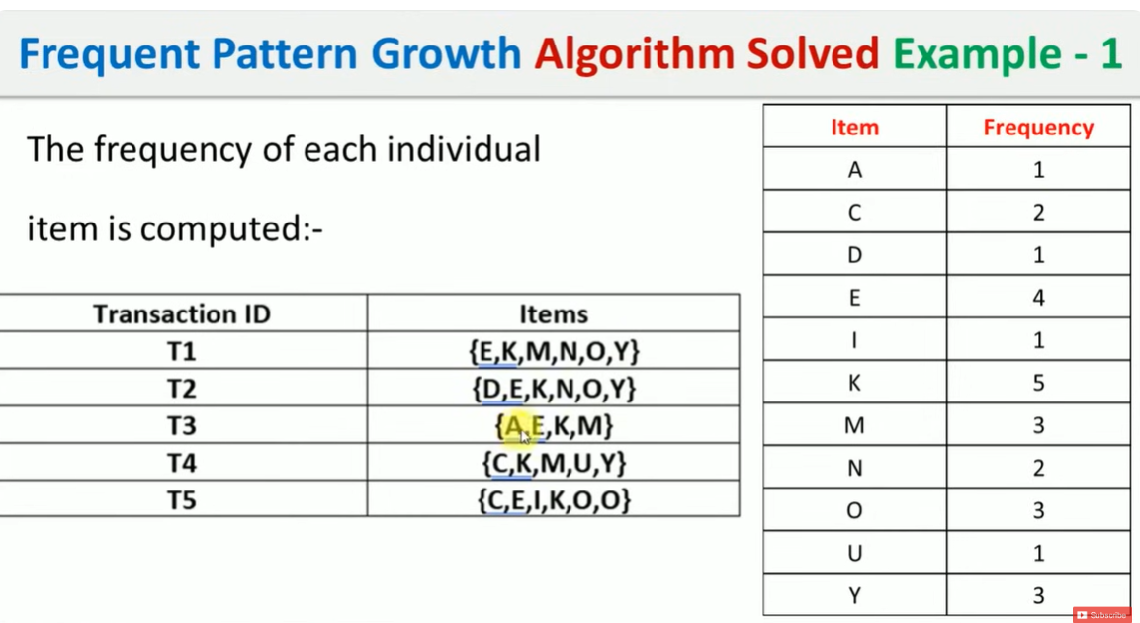

Slide 34
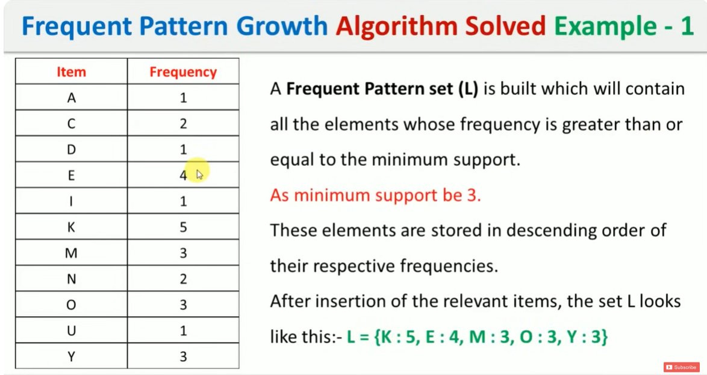

Slide 35
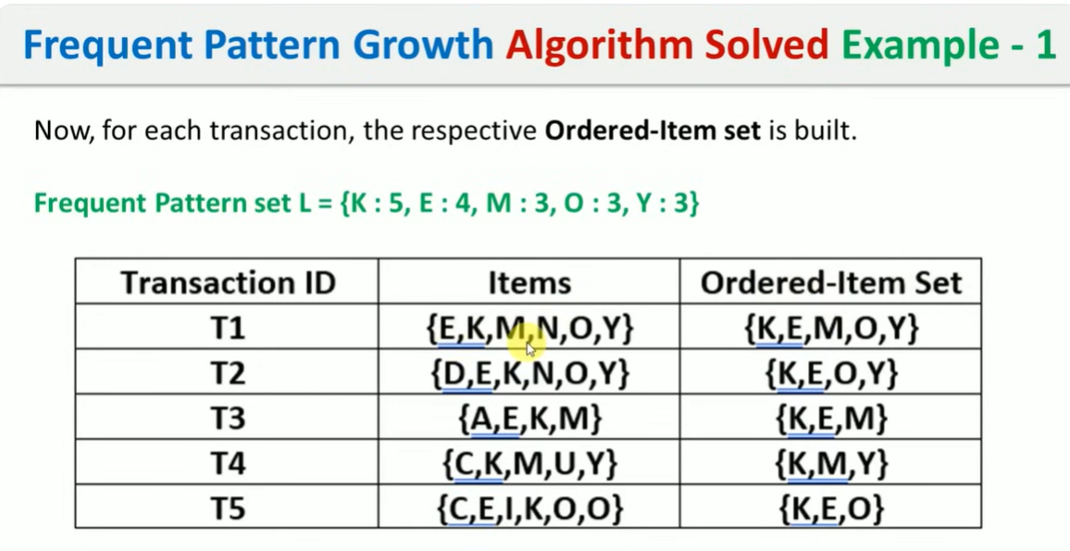

Slide 36
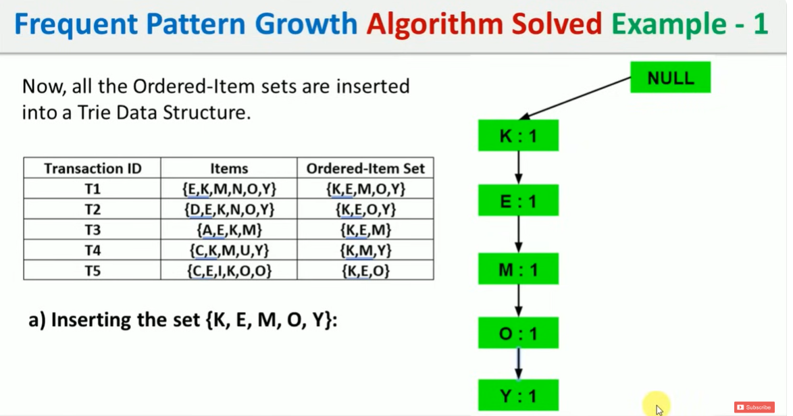

Slide 37
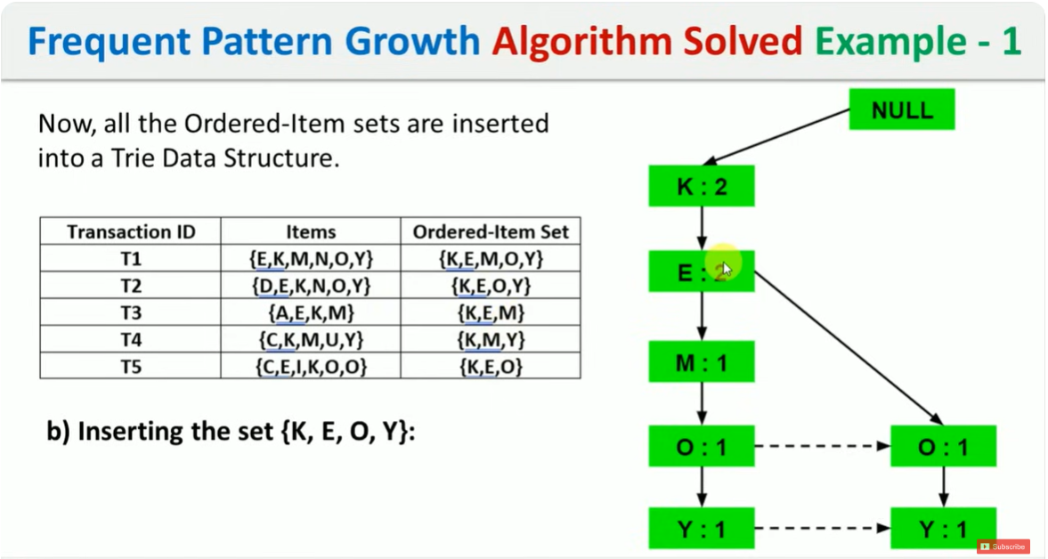

Slide 38
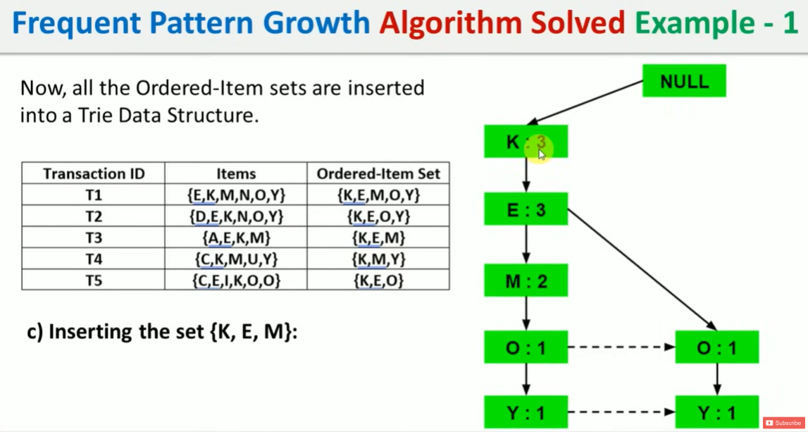

Slide 39
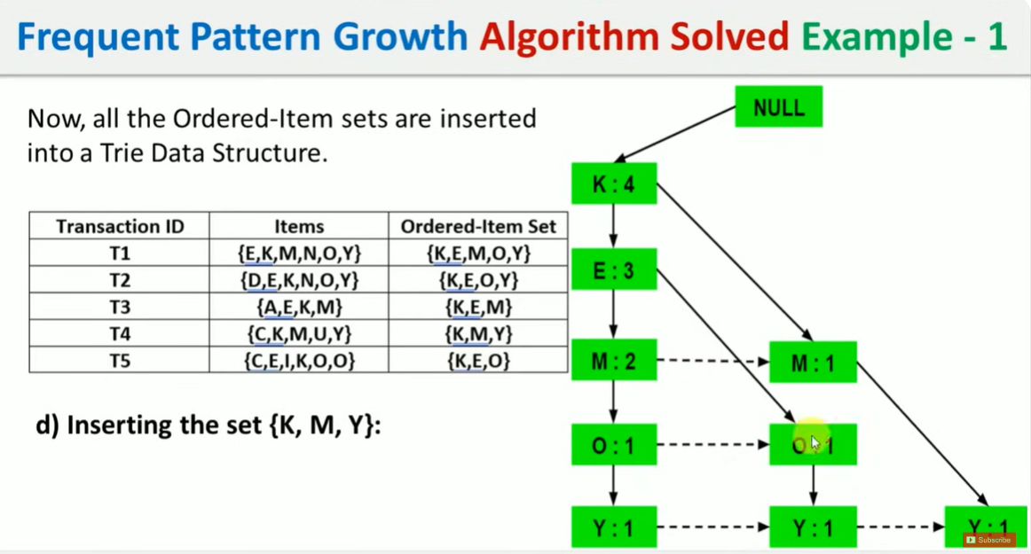

Slide 40
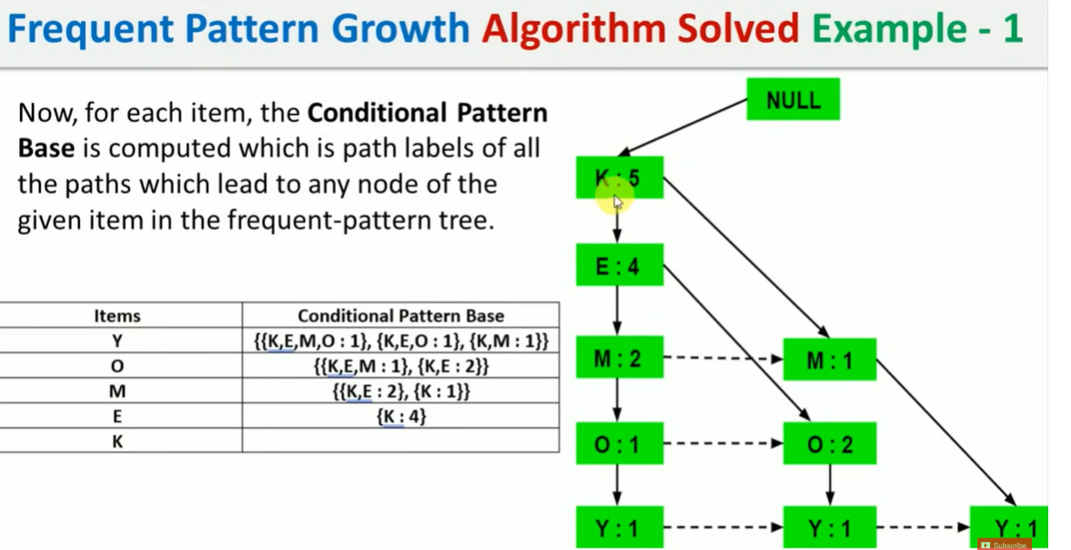



Slide 41
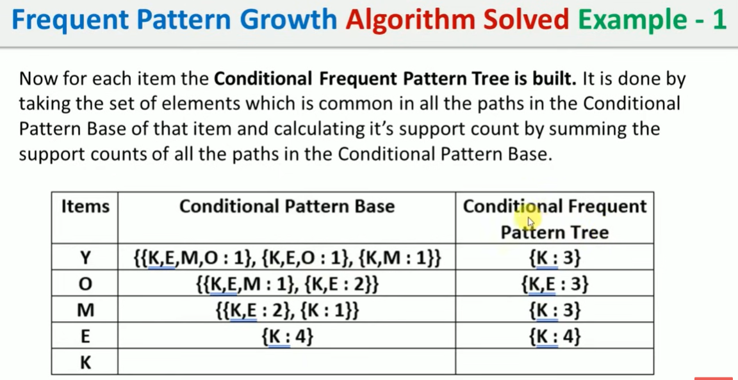


1+1+1=3

Slide 42
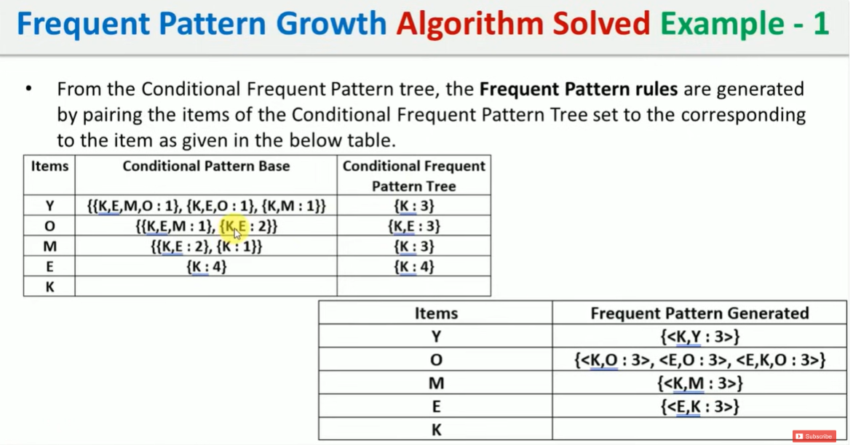



Slide 43
Identified Frequent Patterns (Itemsets): The primary inference is the set of frequent itemsets that meet or exceed the specified minimum support of 3. These are:
<K,Y : 3>
<K,O : 3>
<E,O : 3>
<K,E,O : 3>
<K,M : 3>
<K,E : 4> Inference: The pattern <K,E : 4> signifies that items K and E appear together in at least 4 transactions.

Slide 44
The pattern <K,E,O : 3> shows that K, E, and O frequently occur together in at least 3 transactions.
Efficiency of FP-Growth: The FP-growth algorithm's process, as illustrated, shows how it avoids the explicit candidate generation step (unlike Apriori) by constructing an FP-tree and then mining conditional pattern bases, which is a key advantage for efficiency, especially with large datasets.

Slide 45
Classwork problem
Transaction ID | Items Purchased
T1 | a, b
T2 | b, c, d
T3 | a, c, d, e
T4 | a, d, e
T5 | a, b, c

Slide 46
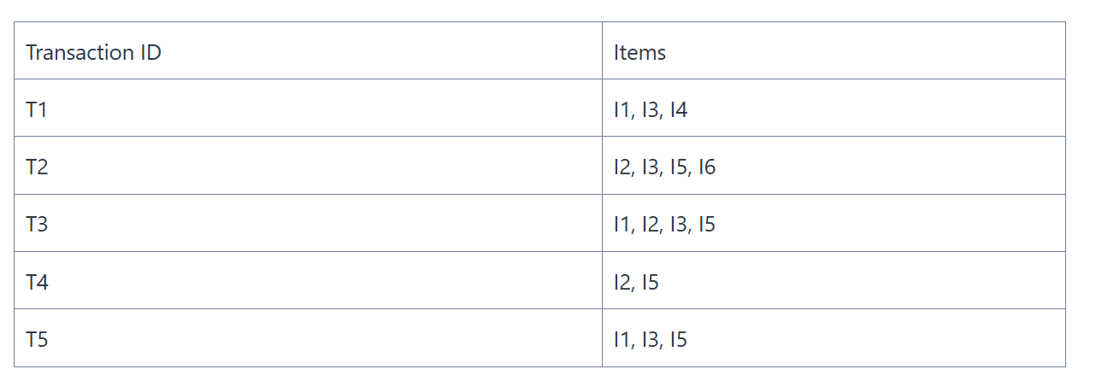
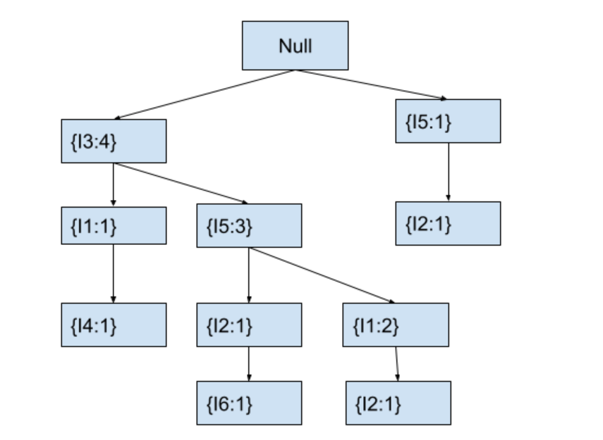
Problem 2:

Slide 47
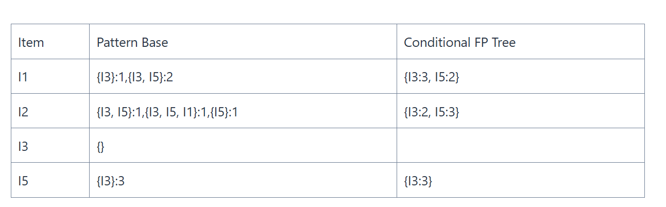

Slide 48
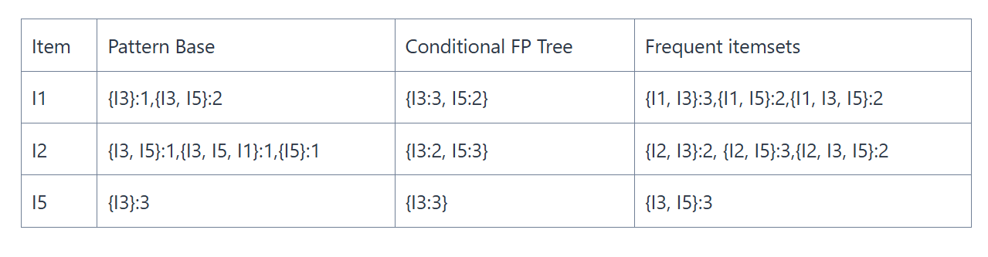

Slide 49
Vertical data format
The vertical data format (also known as transaction ID-based or tid-list format) is primarily used in frequent pattern mining algorithms such as ECLAT (Equivalence Class Clustering and bottom-up Lattice Traversal). It provides an alternative representation to the traditional horizontal format (item-per-transaction).
Table 6.1: A transaction database (horizontal data format)
The corresponding vertical data format
TID | Items
10 | {a, b, c, d, e, f}
20 | {b, c, e, g}
30 | {a, c, d, e, f, h}
40 | {b, d, f, e, j}
50 | {b, c, k, f}
Item | TID_set
a | {10, 30}
b | {10, 20, 40, 50}
c | {10, 20, 30, 50}
d | {10, 30, 40}
e | {10, 20, 30, 40}
f | {10, 30, 40, 50}
g | {20}
h | {30}
j | {40}
k | {50}
This example effectively demonstrates how each item is mapped to the set of transaction IDs where it appears, which is the essence of the vertical data format.

Slide 50
Mining Closed and Max pattern
A real-time grocery store example with 3 simple transactions and show what is a closed itemset, step-by-step.
TID | Items Purchased
T1 | Milk, Bread, Butter
T2 | Milk, Bread
T3 | Milk, Butter

Slide 51
📊 Step 1: Count Support of All Itemsets
Itemset | Support Count
Milk | 3
Bread | 2
Butter | 2
Milk, Bread | 2
Milk, Butter | 2
Bread, Butter | 1
Milk, Bread, Butter | 1

Slide 52
✅ Step 2: Identify Closed Itemsets
🔎 Rule: An itemset is closed if non of the superset has the same support.
🔍 Check Each Itemset:
Milk = 3
Supersets: Milk, Bread (2),
Milk, Butter (2), Milk, Bread, Butter (1) ✅ No superset has support = 3 → Closed
Bread = 2
Superset: Milk, Bread = 2 → ❌ Not Closed
Butter = 2
Superset: Milk, Butter = 2 → ❌ Not Closed
Milk, Bread = 2
Superset: Milk, Bread, Butter = 1 ✅ No superset with support = 2 → Closed
Milk, Butter = 2
Superset: Milk, Bread, Butter = 1 ✅ No superset with support = 2 → Closed
Bread, Butter = 1
Superset: Milk, Bread, Butter = 1 ✅ No superset with support = 1 → Closed
Milk, Bread, Butter = 1
No supersets → ✅ Closed

Slide 53
✅ Final Closed Frequent Itemsets:
Closed Itemset | Support
Milk | 3
Milk, Bread | 2
Milk, Butter | 2
Bread, Butter | 1
Milk, Bread, Butter | 1
💡 Why Important?
Closed itemsets give complete support info without redundancy.
They help reduce the number of patterns while keeping important frequency details.

Slide 54
Maximal Frequent Itemset
Let’s use the same grocery store example with 3 transactions to illustrate max patterns (maximal frequent itemsets).
🛒 Transactions
TID | Items Purchased
T1 | Milk, Bread, Butter
T2 | Milk, Bread
T3 | Milk, Butter

Slide 55
📊 Step 1: Frequent Itemsets & Support
Itemset | Support
Milk | 3
Bread | 2
Butter | 2
Milk, Bread | 2
Milk, Butter | 2
Bread, Butter | 1
Milk, Bread, Butter | 1
✅ Step 2: Maximal Frequent Itemset Rule
An itemset is maximal frequent if:
It is frequent, AND
It has no frequent superset.

Slide 56
🔍 Evaluate Each:
Milk, Bread, Butter
Support = 1 → ❌ Not frequent (assuming min_sup = 2)
Milk, Bread = 2
Superset = Milk, Bread, Butter (1) → Not frequent ✅ → Maximal
Milk, Butter = 2
Superset = Milk, Bread, Butter (1) → Not frequent ✅ → Maximal
Milk = 3
Has frequent supersets → ❌ Not maximal

Slide 57
🟣 Final Maximal Frequent Itemsets:
Maximal Itemset | Support
Milk, Bread | 2
Milk, Butter | 2
✅ Summary:
Maximal itemsets are frequent and have no frequent supersets.
They reduce the number of patterns to consider but lose exact support info for subsets.

Slide 58
Item Merging
1. Item Merging
Definition: Merging multiple items into a single one if they appear together frequently in transactions.
Purpose: Reduces the number of items to consider and can simplify the mining process.
Example: If items A and B always appear together in transactions, they can be merged into a single item AB.
Advantage:
Reduces redundancy.
Speeds up the mining process by decreasing itemset cardinality.

Slide 59
Sub-Itemset Pruning
Definition: If an itemset is infrequent, then all of its supersets will also be infrequent. So we can prune the search space accordingly.
Purpose: Avoid exploring larger itemsets that will not be frequent, based on the Apriori property.
Example: If itemset {A, B} is infrequent, then we don't need to check {A, B, C}, {A, B, D}, etc.
Advantage:
Reduces computation time.
Efficiently narrows down candidate itemsets.

Slide 60
Item Skipping
Definition: Skip items in transactions that are known to be infrequent or do not contribute to frequent itemsets.
Purpose: Improves efficiency by not considering items that can't form frequent patterns.
Example: If item D is infrequent, when analyzing a transaction like {A, B, D}, we only consider {A, B}.
Advantage:
Reduces the number of items and combinations evaluated in each transaction.

Slide 61
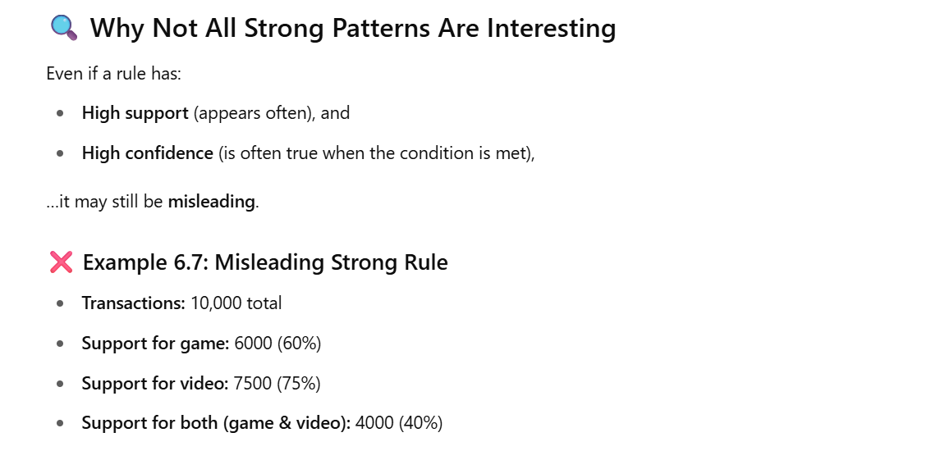
"Which Patterns Are Interesting? — Pattern Evaluation Methods"

Slide 62
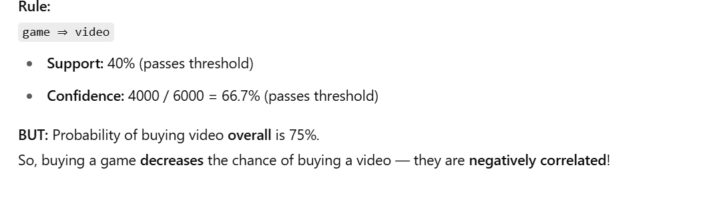
It means “If a person buys a game, they are also likely to buy a video.”

Slide 63
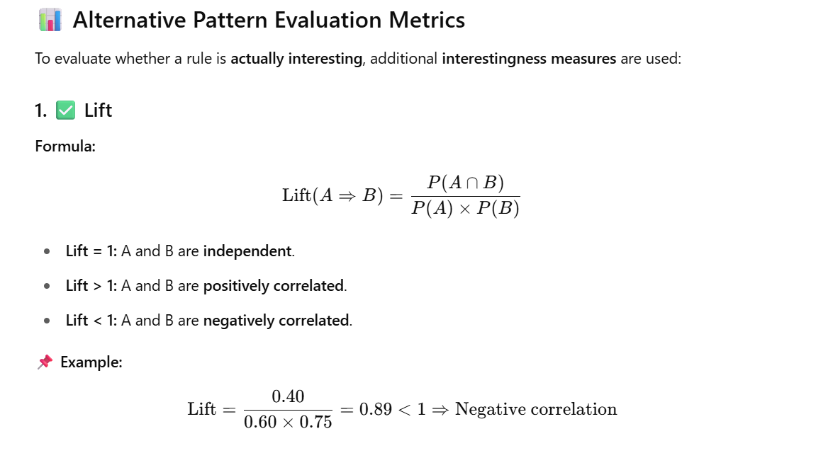

Slide 64
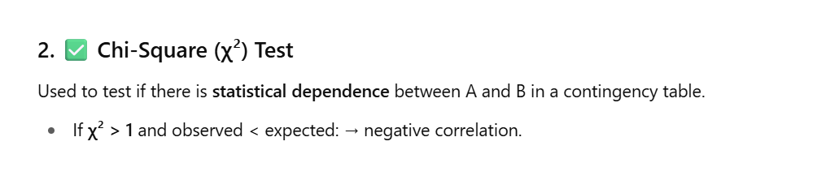
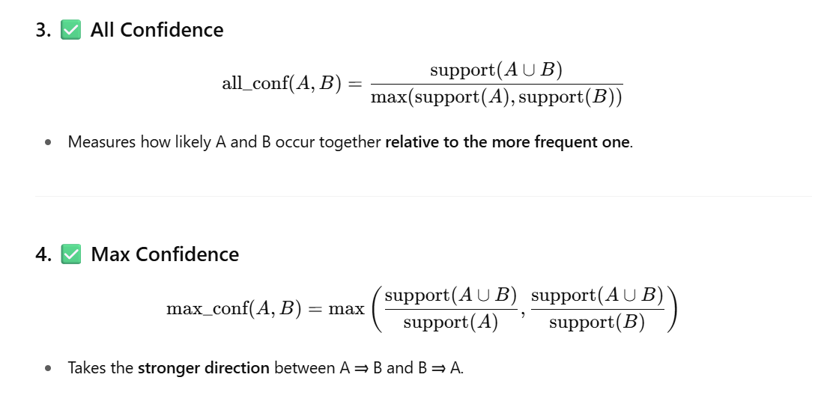

Slide 65
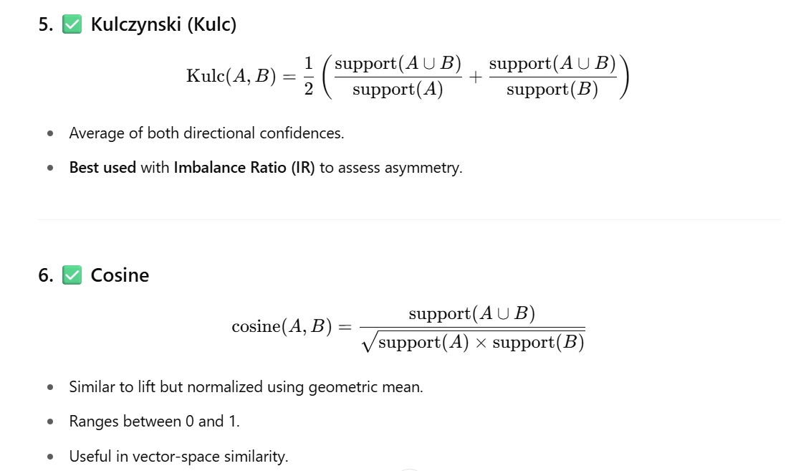

Slide 66
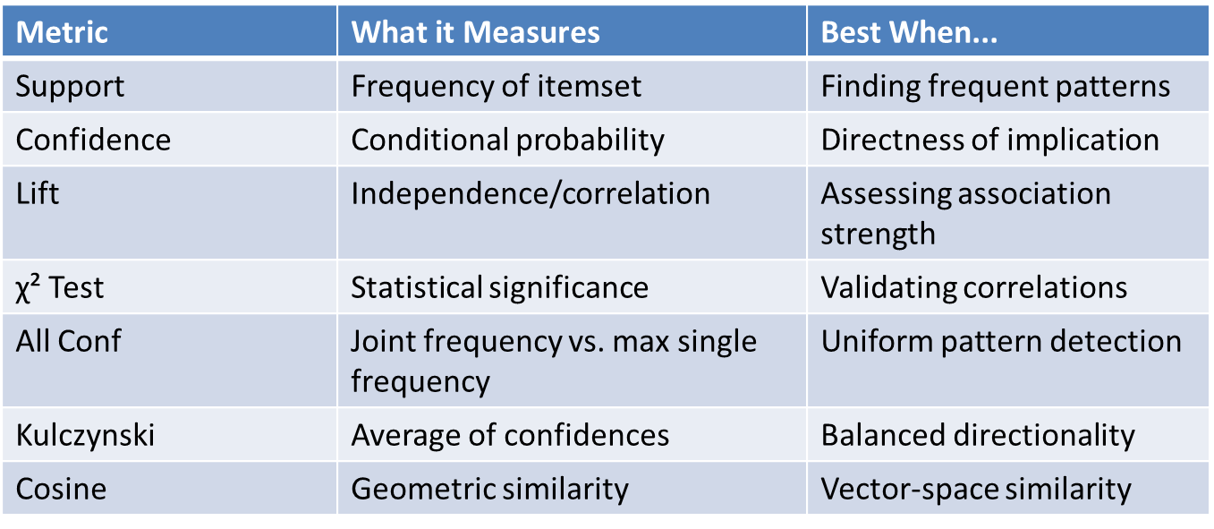
Summary Table

Slide 67
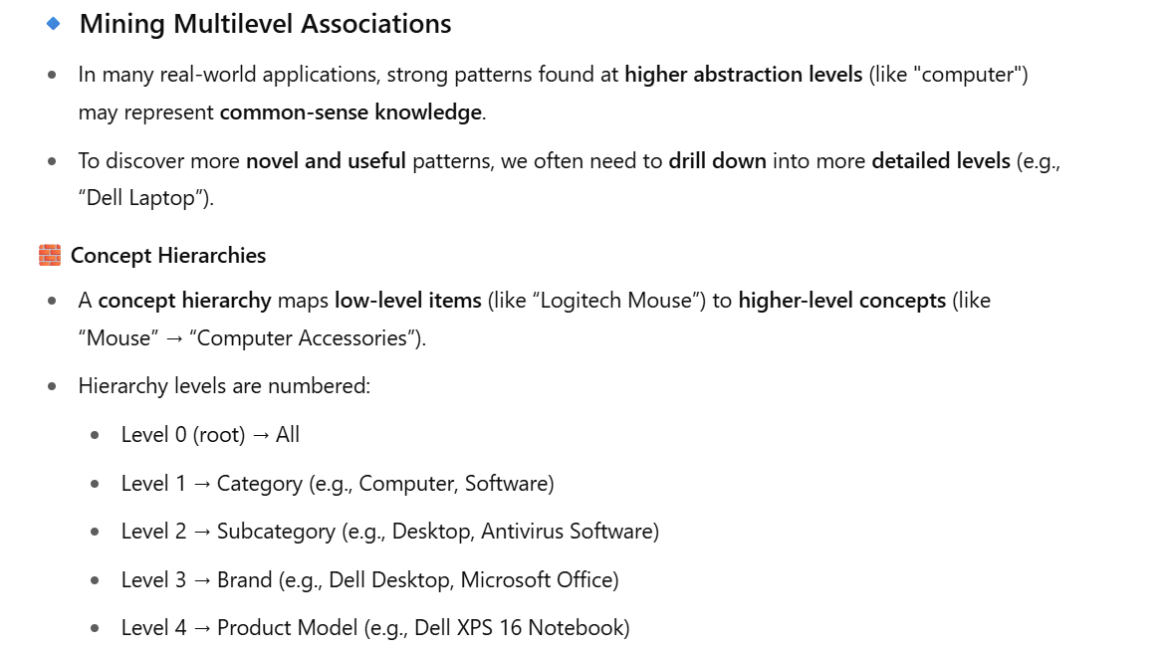
📚 Pattern Mining in Multilevel, Multidimensional Space
Instead of mining rules on raw items like “Logitech VX Nano Mouse”, generalize to “Cordless Mouse” or “Computer Accessories” for stronger patterns.

Slide 68
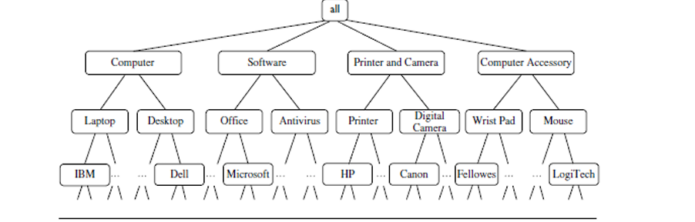
Miningmultilevel association rules.

Slide 69
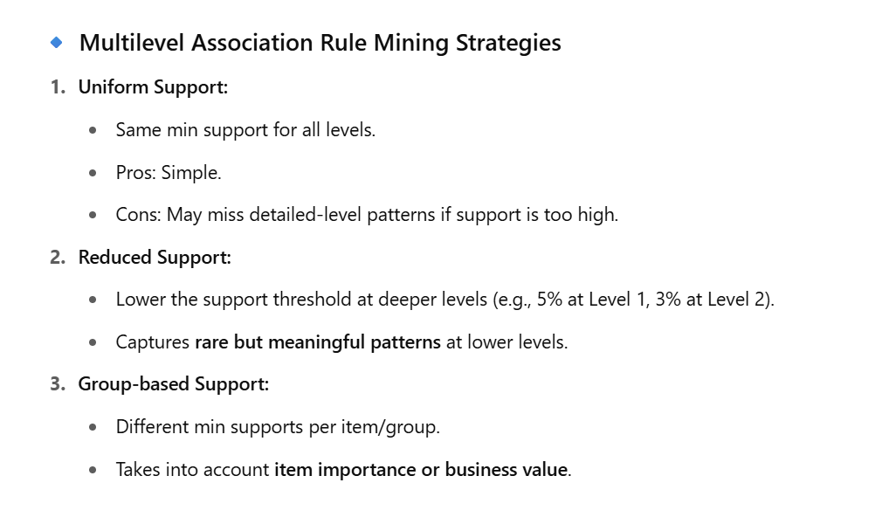

Slide 70
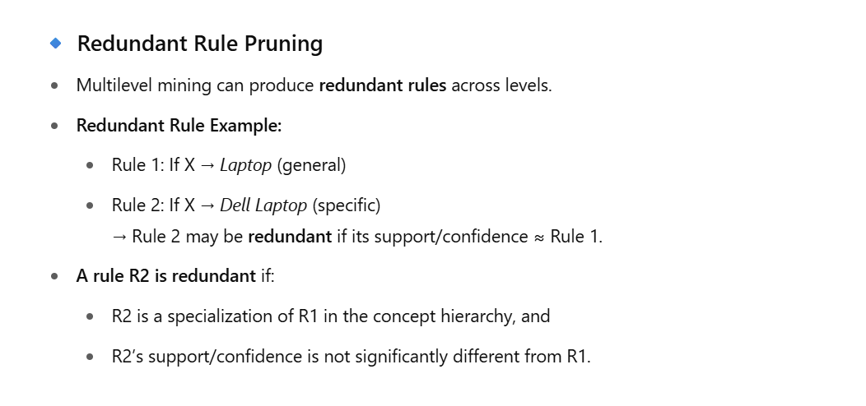

Slide 71
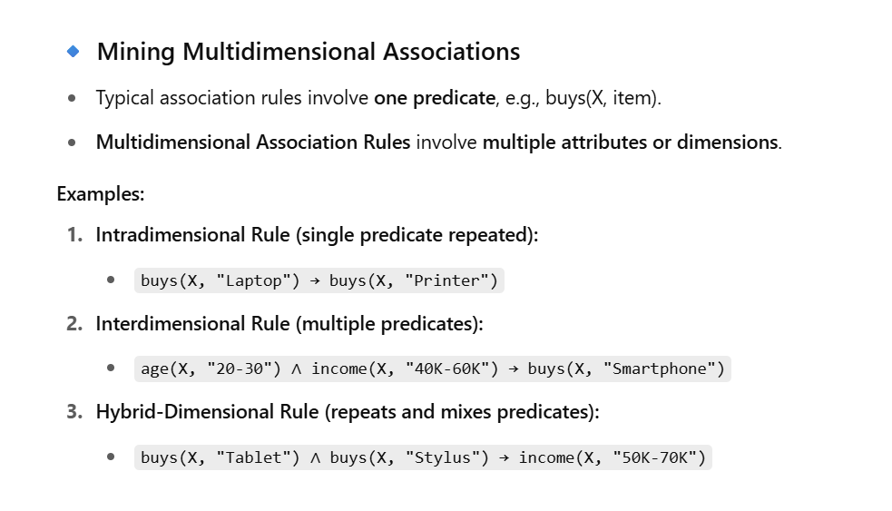

Slide 72
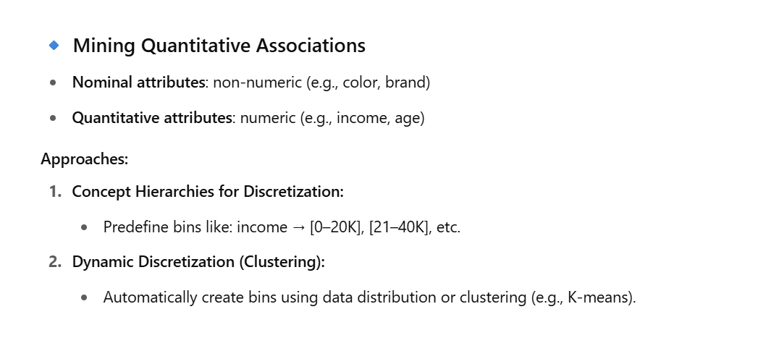

Slide 73


Data Cube based Mining

Slide 74


Slide 75
END

